Slide 1
Dan’s Certification Journey
Dan P. CISSP CISM MCT, Solution Architect
https://github.com/dan-pi/

Slide 2
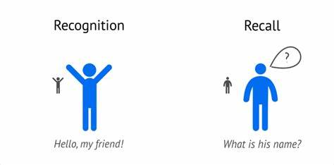
Hello, my friends!

Slide 3

“I know kung fu”

Slide 4

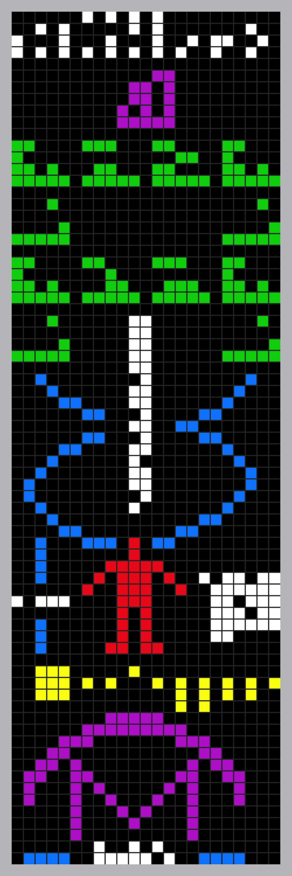
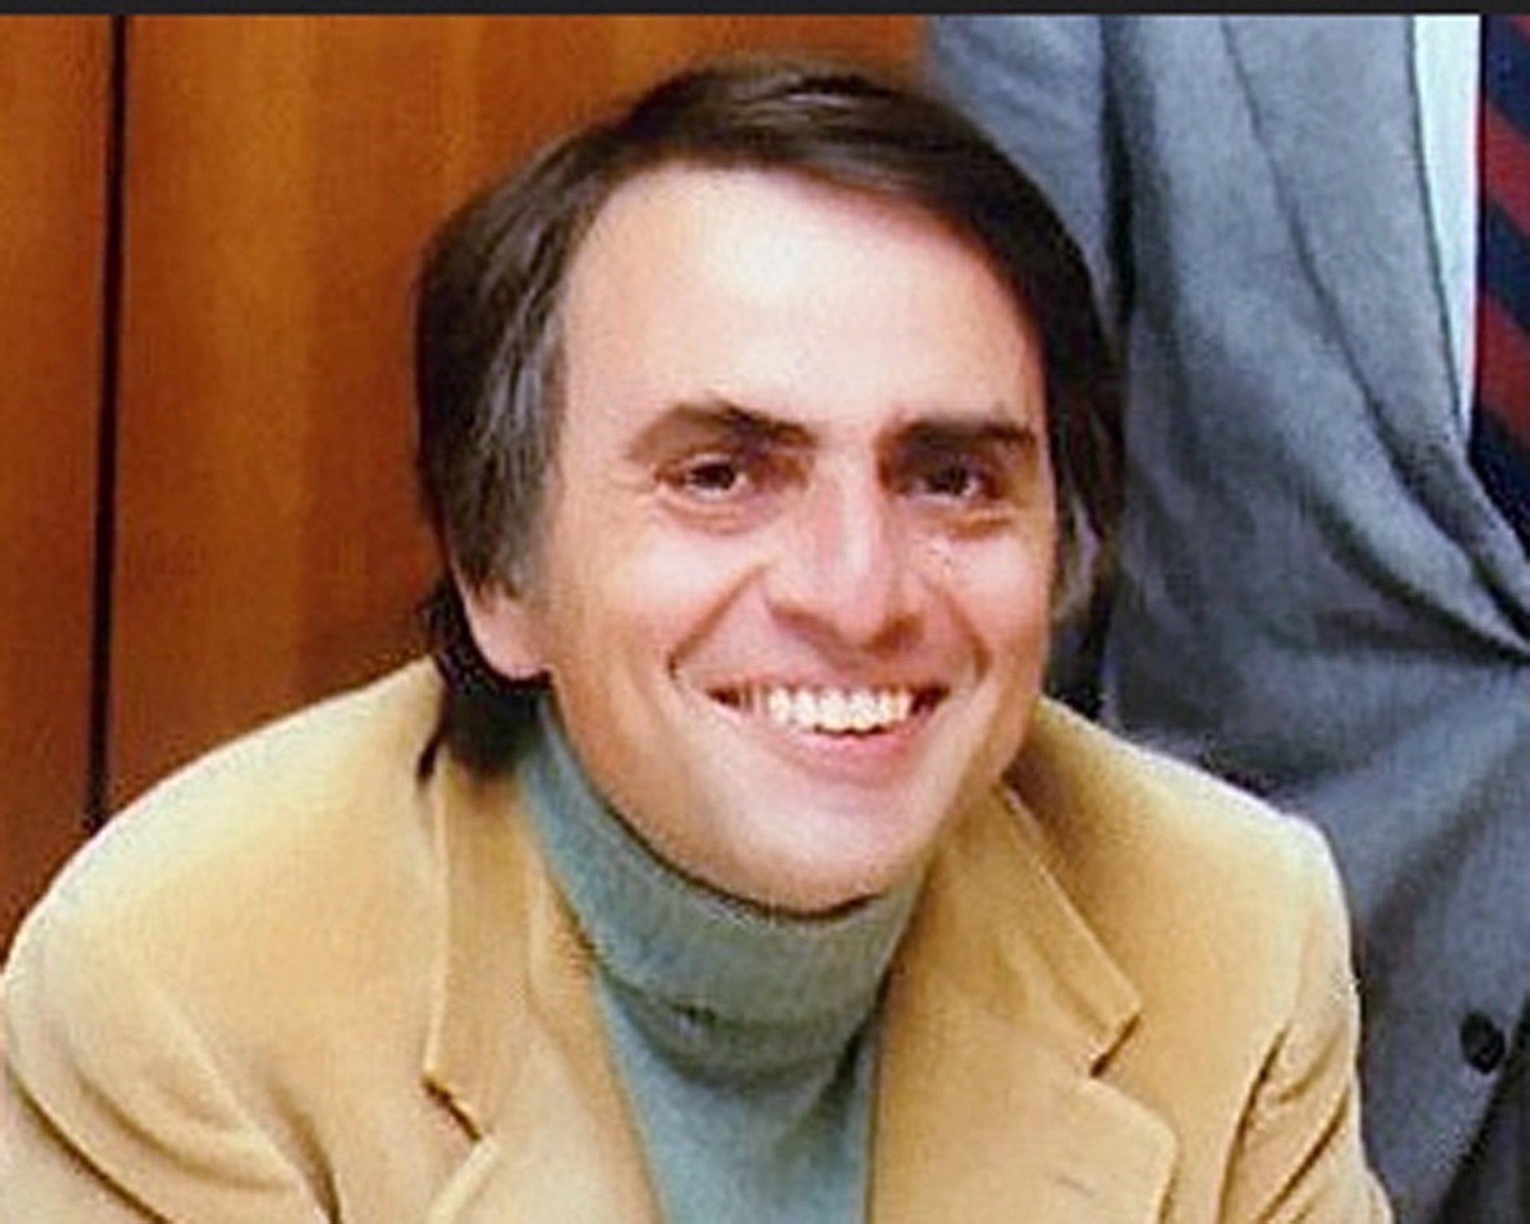
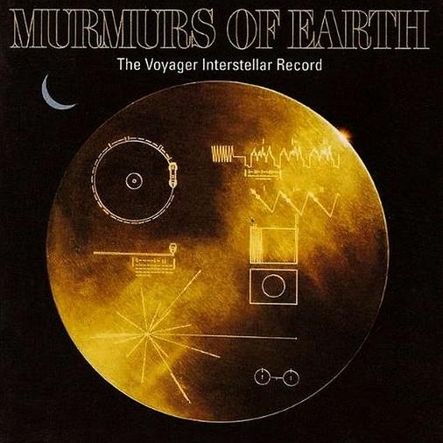
Arecibo message

Slide 5
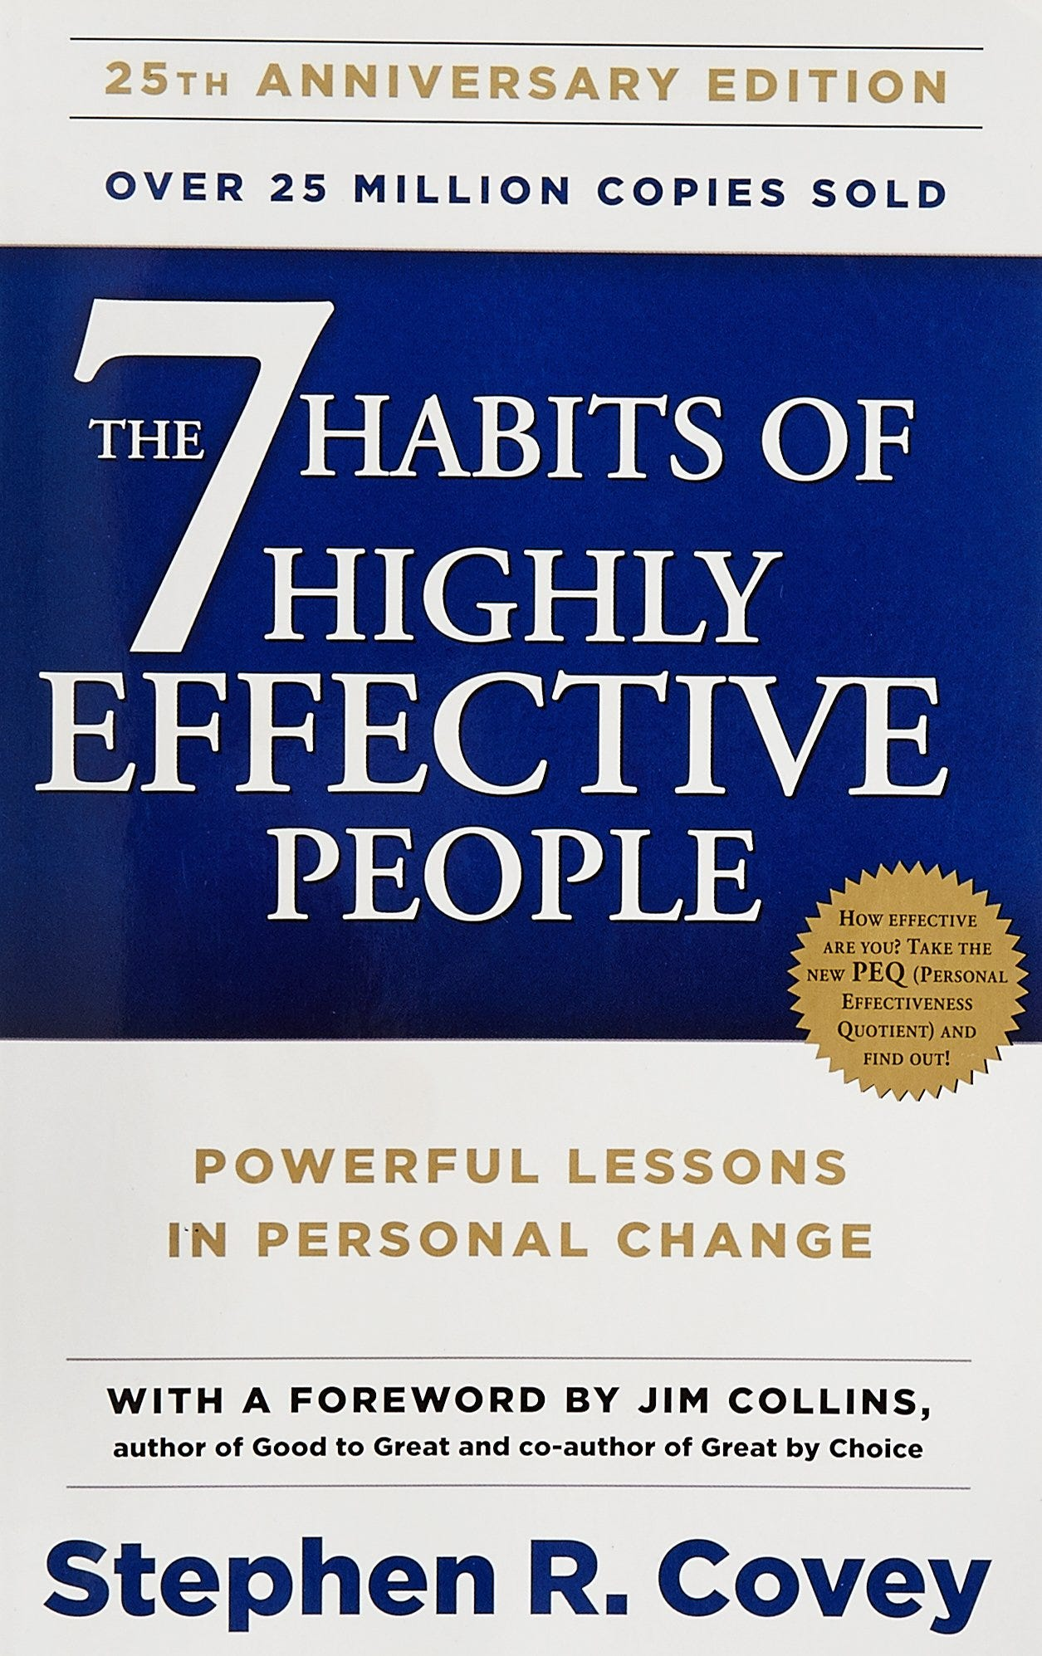
My friend Ali suggested I read this book!

Slide 6
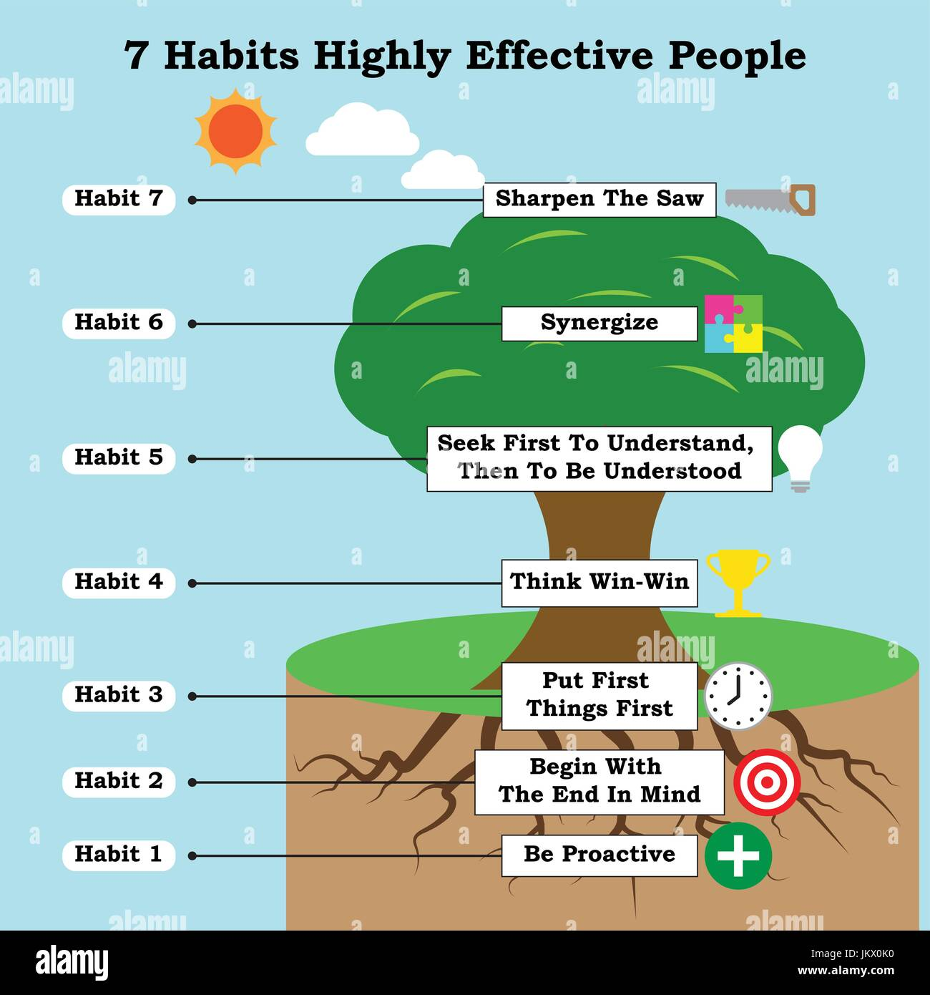

Slide 7
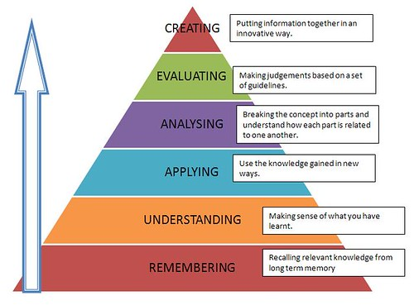
Bloom’s Taxonomy

Slide 8
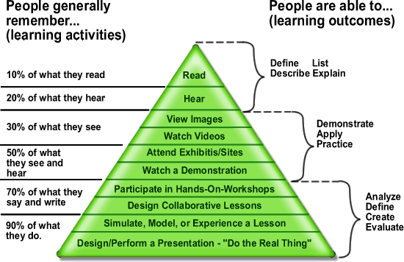
Learning Pyramid

Slide 9
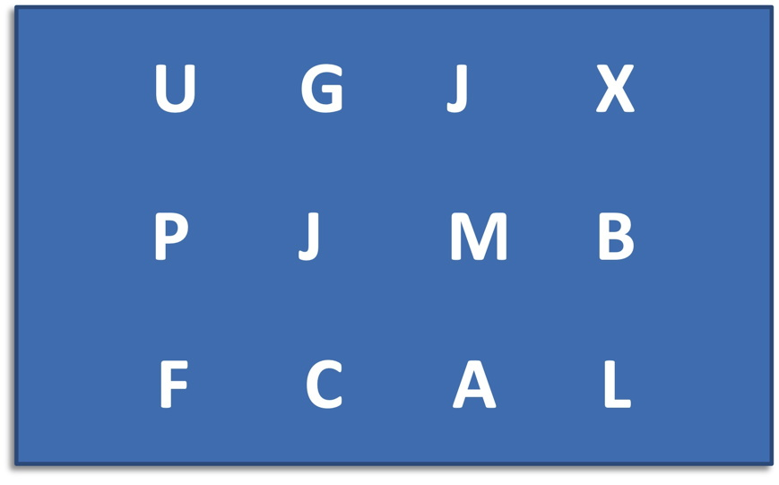

Slide 10
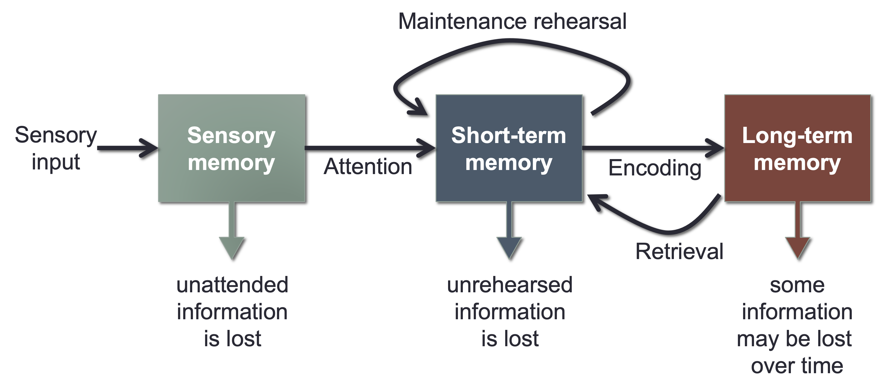
Introduction to Memory and Cognition –Open Educational Resources - PSYC341
https://bobsthinktank.github.io/PSYC341OER/

Slide 11


Slide 12
Sensory memory
Sensory memory preserves information in its original sensory form for a brief time, usually only a fraction of a second
Example: the afterimage created when you move a sparkler very quickly
Some researchers argue that sensory memory is more of an “echo” than a “memory”
Auditory sensory memory (echoic) lasts 2-4 seconds
Visual sensory memory (iconic) lasts approximately ¼ second
George Sperling (1960) experiment on visual sensory store
PSY 1000 - Introduction to Psychology (Zeigler-Hill)

Slide 13
Encoding: Getting information into memory
In general, you need to pay attention to information if you intend to remember it.
Attention involves focusing awareness on a narrowed range of stimuli or events
Selective attention is critical to everyday functioning
Just imagine how poorly you would function if everything in your environment demanded equal attention
Attention acts like a filter that screens out most stimuli
Cocktail party phenomenon
Divided attention impairs performance
PSY 1000 - Introduction to Psychology (Zeigler-Hill)

Slide 14

CISSP Exam Tip
Mnemonic | OSI Layer | Layer
Away | Application | 7
Pizza | Presentation | 6
Sausage | Session | 5
Throw | Transport | 4
Not | Network | 3
Do | Data Link | 2
Please | Physical | 1

Slide 15
Short-term memory
Short-term memory is a limited capacity store that can maintain unrehearsed information for up to about 20 seconds
Selective attention is important for moving information from sensory memory to short-term memory
Limited capacity: magical number 7 plus or minus 2
Chunking: grouping related stimuli for storage as a single unit
Limited duration: about 10-20 seconds without rehearsal
Rehearsal: the process of repetitively verbalizing or thinking about the information
PSY 1000 - Introduction to Psychology (Zeigler-Hill)

Slide 16
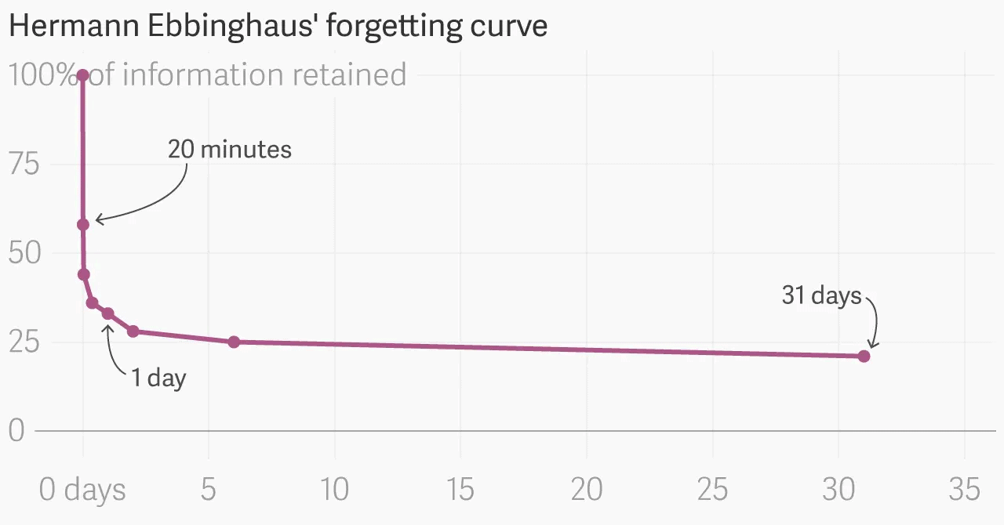
Forgetting Curve

Slide 17
Long-term memory: Unlimited Capacity
Long-term memory is an unlimited capacity store that can hold information over lengthy periods of time
Permanent storage?
Flashbulb memories: unusually vivid and detailed recollections of momentous events
Memory is more malleable and less accurate than generally appreciated
“People will forget what you said, people will forget what you did, but people will never forget how you made them feel.“ – Maya Angelou
"If you don't like something, change it. If you can't change it, change your attitude.“– Maya Angelou
PSY 1000 - Introduction to Psychology (Zeigler-Hill)

Slide 18
Why CISSP? *unpaid ad / copilot generated*
Professional Credibility
Career Advancement
Higher Salary Potential
Broad Knowledge
Networking Opportunities
Employer Preference

Slide 19
Why GitHub? *unpaid ad / ask copilot*
GitHub certifications can transform your career by showcasing your expertise and helping you stand out in the tech world.
They validate not just your technical skills but also your ability to align GitHub tools with business objectives, making you an invaluable asset to any team.
By mastering areas like version control, workflow automation, and security practices, you’ll gain both confidence and credibility.
Earning a certification demonstrates that you’re not only keeping pace with the rapidly evolving tech landscape but also shaping it, positioning yourself as a leader in the field.

Slide 20
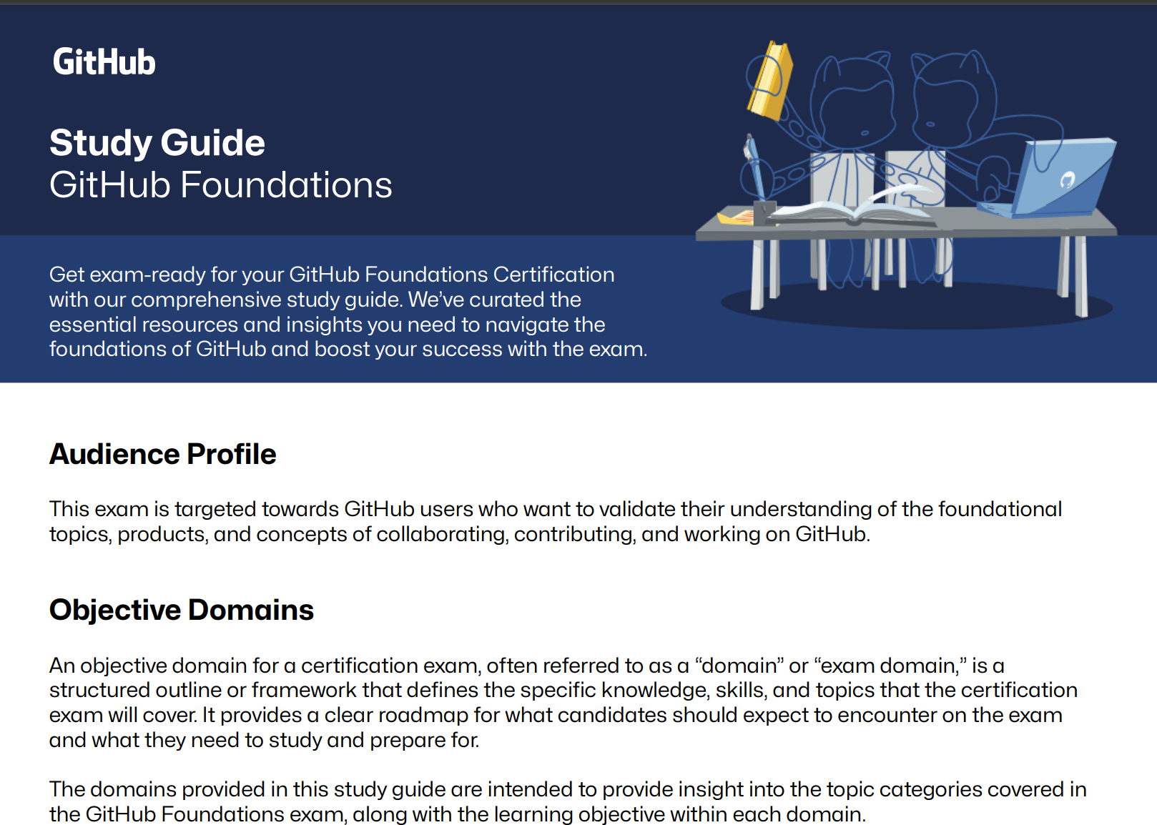
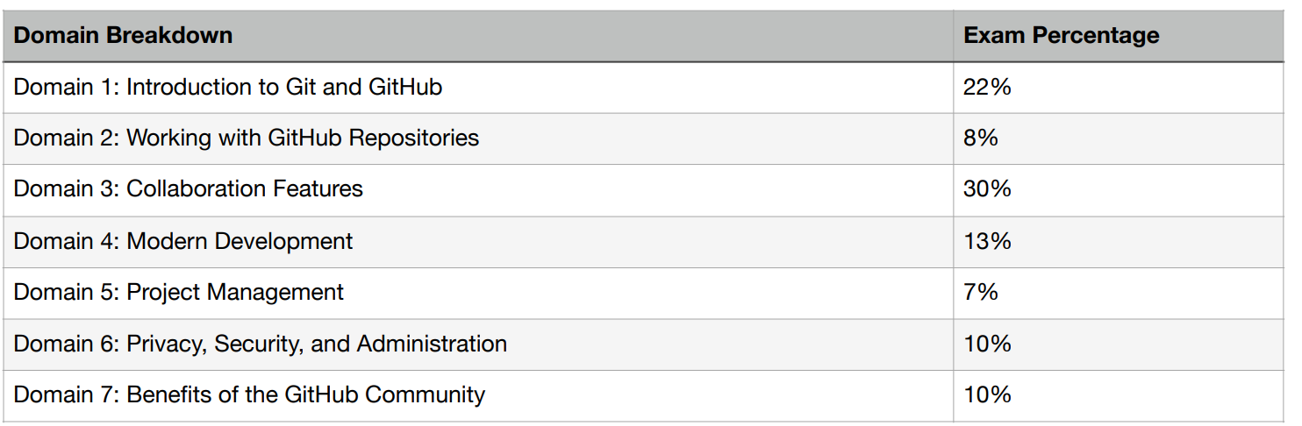
https://github.com/LadyKerr/github-certification-guide/blob/main/study-guides/gh-foundations.md

Slide 21
Study tips
Start at the beginning – foundation level builds confidence!
1. Study Resources – use multiple!
Official learning paths cover most content, however it’s text-heavy;
Use free resources and free trials, including 3rd party video platforms
Check out the study guide so you cover all of the topics on the exam – (sometimes new stuff is added and old stuff is removed from exams!)
2. Hands-On Practice
Do practice exams to validate your learning and build your confidence.
Follow along with tutorials,
Experiment with sample code, clone projects, learn by doing
“If I have seen further, it is by standing on the shoulders of giants.” -Isaac Newton

Slide 22
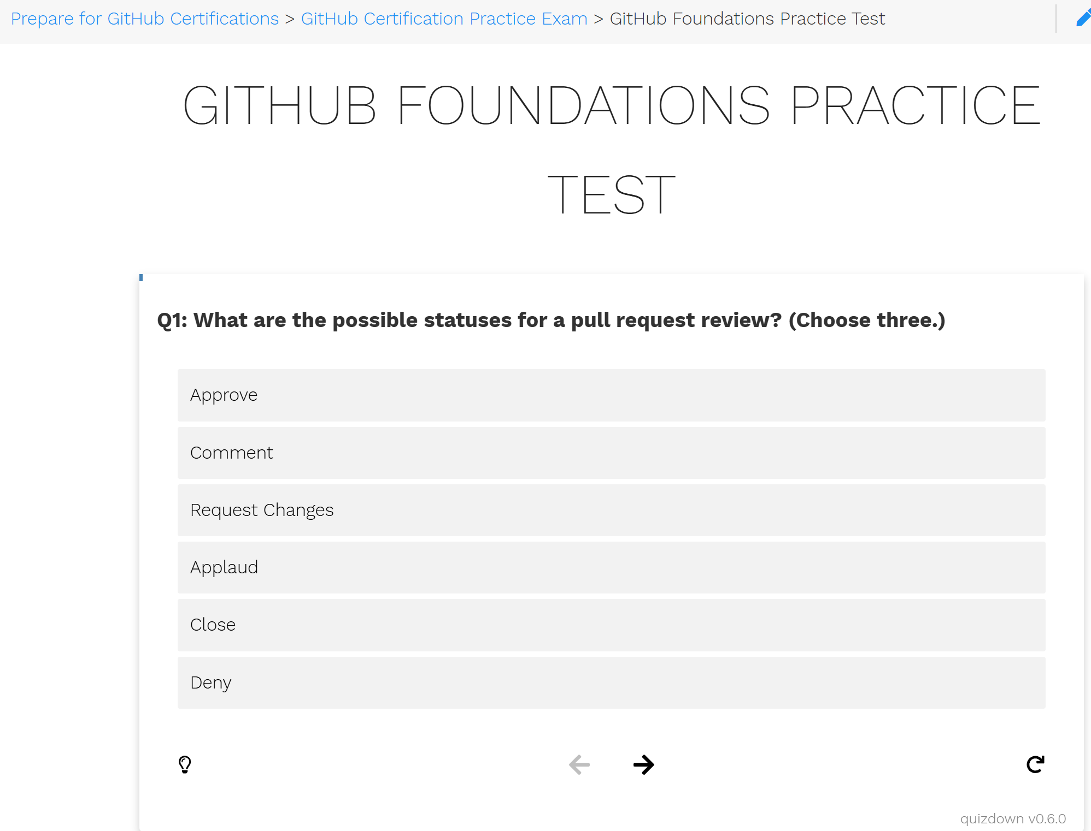
https://ghcertified.com/practice_tests/foundations/

Slide 23
Microsoft / GitHub exam prep resources
Microsoft Learn for GitHub https://learn.microsoft.com/en-us/training/github/ Scroll to bottom, click ‘Register today’ to register
Microsoft’s Exam Readiness Zone https://learn.microsoft.com/en-us/shows/exam-readiness-zone (MCT ~!= GitHub)
GitHub Education https://education.github.com/experiences/foundations_certificate
https://github.com/LadyKerr/github-certification-guide/blob/main/study-guides/gh-foundations.md
Datacamp (free sign-up)
LinkedIn Learning (free trial – all platforms, Udemy, Pluralsight etc. all have free trials, trial them all and find what works for you and share your experience with your friends and colleagues.)
GitHub Education (if you have a .edu email address, unlocks bonus content on the GitHub Education site)
3rd party resources e.g.: https://github.com/btkrausen/github_certification
Candidate Handbook (logistics) https://examregistration.github.com/handbook
GitHub Docs https://docs.github.com/en

Slide 24

Exam tip [0]

Slide 25
Exam tip [1-2]
Prepare
Complete the Microsoft Learn modules, including the Hands-On Labs.
I recommend John Savill’s Technical Training (YouTube, free)
Practice makes progress. Practice tests are a MUST: https://ghcertified.com/practice_tests/foundations/
Keep calm and carry on
- 120 minutes to answer 75 questions.
- Carefully read through each question. Weigh up all of the options.
- Eliminate wrong answers.
- Choose the best available answer.
- If in doubt, trust your gut / professional experience and give your best guess.
- Answer every question.
- Mark any questions if unsure, you can review later if there is time left at the end.
- Try not to second guess yourself. Only change your answer if confident you misread or misunderstood the question first time round.
- Stay calm and focused — there’s no need to rush.

Slide 26

Gooaaaaal!!!!
Congratulations!
After completing the exam, you will receive your results immediately (or not, on beta or advanced exam results may be a 12-24 hours delay.)
When you pass, you will be awarded a GitHub Foundations Badge and Certificate issued by Credly. These credentials can be showcased on your resume or LinkedIn profile to highlight your accomplishment.
If you don’t pass first time around (it happens!), check the feedback for areas to review, then take some more practice exams. You will pass the next time!

Slide 27
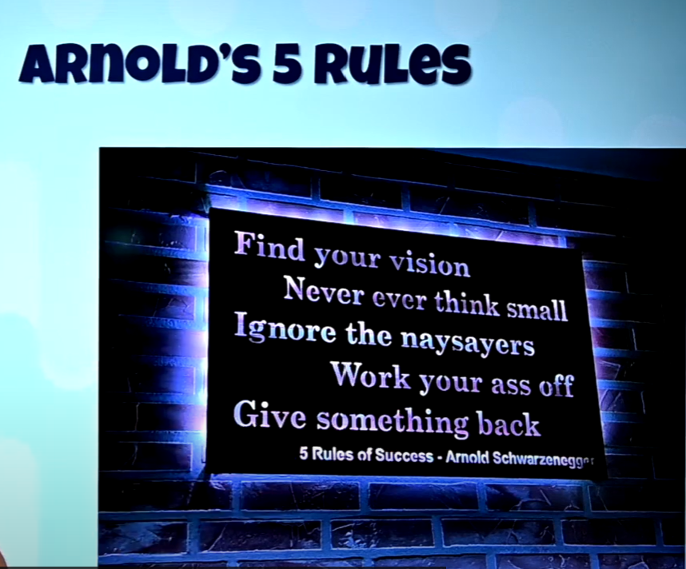
John Savill’s Technical Training
DevOps Master Class https://www.youtube.com/watch?v=YMdtaWfU_QE
Azure Master Class v3 https://www.youtube.com/watch?v=afzzawldfFk
Azure Weekly update https://www.youtube.com/watch?v=IYShpL69FJQ
Keynote – Arnold’s 5 rules https://www.youtube.com/watch?v=5KhdPCfddZY

Slide 28
Covey’s 8th habit
find your voice and inspire others to find theirs. This habit is about leadership and determining your unique contribution to the world.
According to Covey, great leaders work on themselves first, making sure they’re balanced, well-rounded human beings before they try to influence others.
The 8th habit is about inspiring others to find their voice and harness their real human potential. It takes profound personal reflection and asking deep questions to yourself to define your purpose and meaning.

Slide 29


